Slide 1

Great Western Route Modernization
Vasu Singh
Shravan S Ranga
Srikanth Ranganathan
Aman Rahimatpure

Slide 2
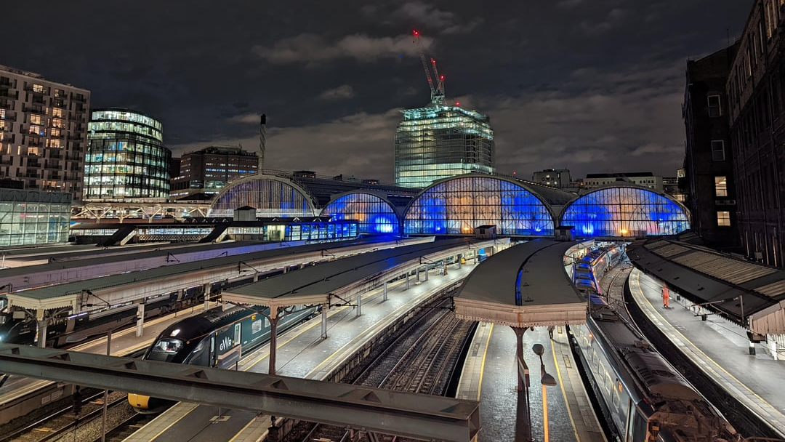
Project description
Our project aims to analyze the lessons learnt from the Great Western Route Modernization program from a project management perspective. Throughout our research, we will discuss the positive efforts and the systematic shortcomings which caused the huge delay in the UK's electrification program.

Slide 3
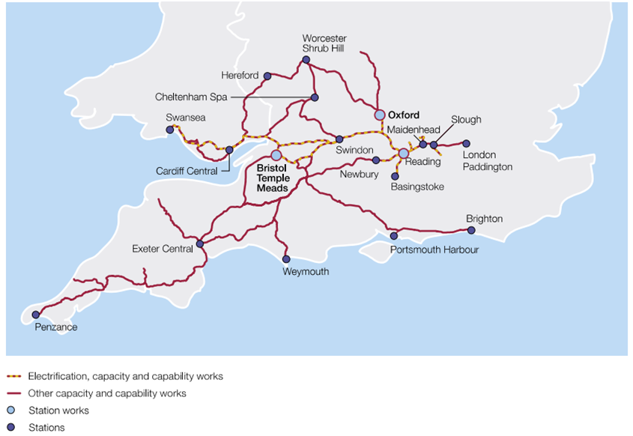
Phases of electrification
Phase 1 : Paddington to Bristol Parkway
Phase 2 : Bristol Parkway and sub-lines to Cardiff
Phase 1 : Paddington to Bristol Parkway
Phase 2 : Bristol Parkway and sub-lines to Cardiff

Slide 4
LESSONS LEARNT
Importance of Scope
Proactive Risk Assessment
Stakeholder Expectations
We can see how "scope creep" hugely affects the timeline and financial side of a program
A mix of positive and negative efforts led to ambiguous results and no defined risk factor
Negligence can be costly
Establishing a clear channel of communication and early engagement can change the direction of a team
The budget rose from 1.6B£ to £2.8B (75% increase) and there was a 2-year delay due to poor planning.

Slide 5

Consequences of scope expansion
Frequent Changes:
Constant modifications due to evolving stakeholder inputs and newly discovered needs.
Increased Complexity:
Managing additional tasks and integrating new requirements escalated project complexity.
Resource Demands:
Additional time, materials, labor, and finances needed for each change led to resource shortages elsewhere in the project.

Slide 6
Importance of Schedule planning
Crucial for managing project deadlines and identifying potential delays.
Can Identify challenges in co-ordination with stakeholders.
Avoid unforseen technical issues with a backup plan.
Potential delays can be mitigated and corrective actions can be taken much faster.

Slide 7

Stakeholder management
Clear & Continuous Communication
Essential for addressing concerns and gathering feedback.
Fosters collaboration, aligns expectations, and minimizes misunderstandings.
Insufficient Early Engagement
Delays and resistance due to not involving some local communities early enough.
Collaboration with Local Authorities
Mitigated disruptions by involving local authorities and communities early.
Notes:
Titles don’t need bullet points.. Just bold em

Slide 8
Risk management
Proactive risk identification - Identifying potential risks early on is crucial. The rise in costs would affect the procurement plan for the electrification and this was not considered.
Positive efforts - early risk identification and risk mitigation strategies
Challenges and Shortcomings - Underestimation of complexity and communication of risks

Slide 9
Cost management
Cost overruns and budget issues - due to unforeseen technical difficulties such as design flaws, inefficient part installation, station upgrades the overall rise of cost was significant
Inflation and market conditions - huge rise in the cost of steel due to inflation, labor costs rose as well due to poor working conditions and workers strike.
Without a critical path analysis before starting electrification delivery resulted in missed dependencies and increased installation costs.

Slide 10
Quality and integration management
Coordinated Planning: Integration management aligned objectives and timelines across stakeholders, ensuring unified progress.
Enhanced Communication: Improved communication reduced misunderstandings and delays among teams and departments.
Fragmented Implementation: Inconsistent management led to delays and cost overruns, showing weak integration.
Inadequate Risk Management: Lack of strong risk mitigation strategies led to unaddressed critical issues.

Slide 11
Recommendations and corrections
Continuous monitoring and budget reassessments should have been implemented from the start of phase 1.
Advanced technological techniques like Building Information Modeling (BIM) and Geographic Information Systems (GIS) should have been used to cut costs and reduce timelines.
Stakeholder relations should have been focused on and continuous feedback from the public domain should have been taken.
Predictive (Waterfall) was not carried out efficiently and I would advise them to switch to a hybrid approach.

Slide 12

Conclusion
Despite facing significant challenges in planning, scheduling, and budgeting, the project has made notable progress, particularly in the electrification of key segments.
Utilizing proper feedback and a good technical team could have saved a lot of money and ensured completion within the original timeline.
One of the areas of contention related to budgeting constraints could be the shutdown of major terminals while the project was active, due to active construction work and electrification.

Slide 13
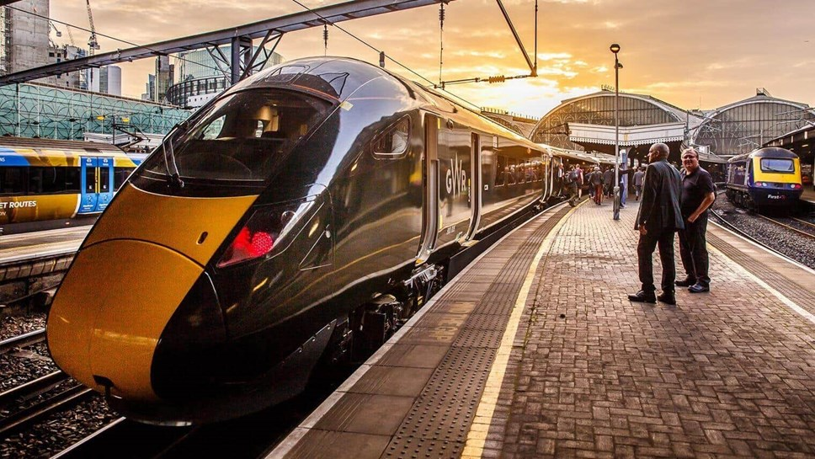
Thank you

